Slide 1
Wow Technical Deliverable
ESG-205/Data movement from old to new servers for application upgrade
03-September-2019

Slide 2
Problem Statement
Data movement from old servers to new servers during application upgrade and migration
Preserving the permissions and ownerships of the data while migrating them to new servers.

Slide 3
Mirroring in MapR
Mirroring is a parallel operation, copying data directly from the nodes of one MapR cluster to the nodes in a requested MapR cluster. The contents of the volume are mirrored consistently, even if the files in the volume are being written to or deleted
It’s a faster method as it uses low bandwidth and compresses the data while mirroring.
Mirroring can be scheduled or manual as per requirement.
There are two type of mirroring: LOCAL and REMOTE

Slide 4
Local Mirroring
A local mirror volume is a mirror volume whose source is on the same cluster.
We can locate our local mirror volumes in specific servers or on racks with particularly high bandwidth, mounted in a public directory separate from the source volume.
Local mirror volumes are useful for load balancing
Local mirror volumes are useful for providing a read-only copy of frequently accessed volumes

Slide 5
Remote Mirroring
A remote mirror volume is a mirror volume with a source in another cluster
Remote mirror volumes are useful for offsite backup
Remote mirror volumes are useful for data transfer to remote facilities
Remote mirror volumes are useful for load and latency balancing for large websites

Slide 6
Prerequisites for Mirroring
Each cluster entry should be having both source and destination CLDB details
Each cluster must be already set up and running
Each cluster must have a unique name
The userid of admin user must be same in both source and destination clutser
The dump and restore permissions must be available to the user executing the mirroring

Slide 7
mapr-cluster.conf
Add the CLDB entries of the other cluster in this file and restart API server and NFS server
The first line in the file should be own cluster and the other cluster CLDB should be added in the next line
Incase the order is altered, it would create confusion for CLDB to know which cluster is theirs and which is others

Slide 8
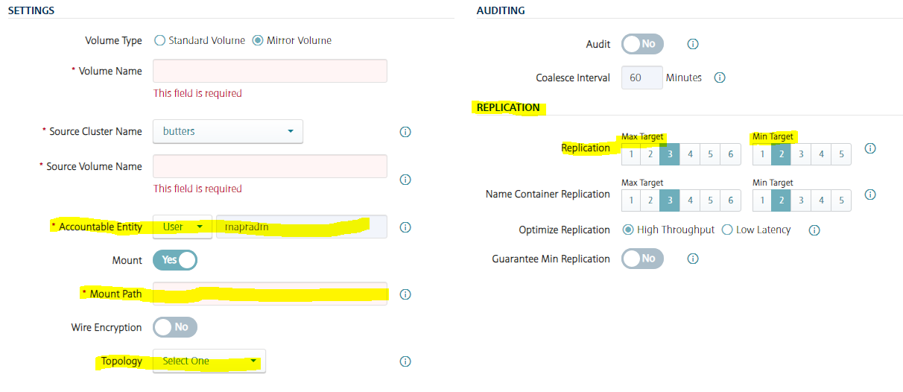
Mirroring Characteristics
The different characteristics which can be different than source are:
Replication
Topology
Accountable Entity
Mount Information
The setting of the mirror volume can be changed anytime as per the requirement

Slide 9
Steps for Mirroring
Login to MCS and go to Volumes section
Select create new volume and select type as mirror volume.
Then give a name for the mirror volume
Specify the source volume from where the mirror retrieves it content.
If the mirror volume is to be mounted then specify the mount path
After the volume is created, select on Action and choose Start Mirroring.
Through CLI :
Maprcli volume create –name MirrorVol –path FullPathOfMirrorVol –type mirror –source SourceVol@SourceClusterName
Maprcli volume mirror start –name mirrorVol

Slide 10
Promotable Mirrors
If a read-write volume with critical data goes down in source cluster, a mirror volume in the destination cluster can be made into a read-write volume in order to maintain business continuity. Later, if the source cluster comes back online, the original mirror relationship can be restored by making the new read-write volume back into a mirror volume.
Running applications on a copy of production data to test the different hadoop services on that volume
Through CLI:
Maprcli volume modify –name MirrorVol –type rw
Through MCS:
Select the mirror volume, click on Actions and select “Change to Standard Volume”

Slide 11
"
THANK YOU

